Slide 1

CS 201 : Object Oriented Design & Programming
GROUP-7
Presenting ...
OOPs Based Project On Vehicle Rental System

Slide 2



Slide 3
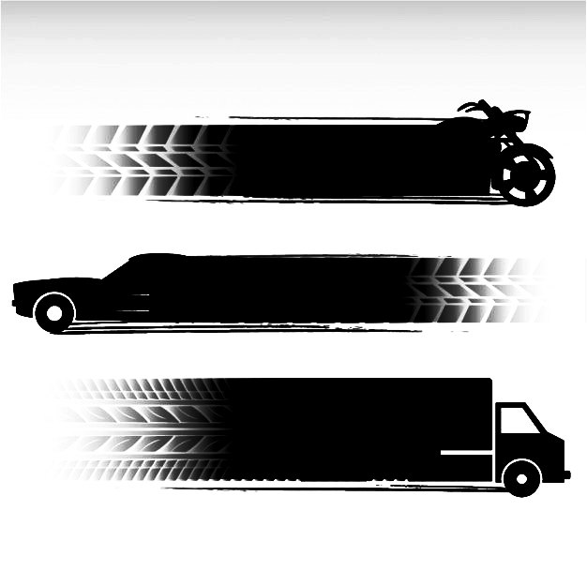

ABOUT US :
Aniruddha Kajave
202111006
Vaahan Wallah is a system time based simulator for customers seeking flexible vehicle rentals on variety of classic cars , bikes and buses. for ease of transportation and availability around the streets, anywhere and anytime.
Akanksha Pandey
202111004
Harsh Taunk
202111035
Jayesh Chak
202111040
Vinayak
Team Members →
202111018

Slide 4

OVERVIEW :
Prototype
Features
Requirements
Working Methodology
Concepts Used
Scope Of Improvement

Slide 5
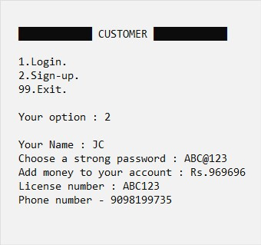


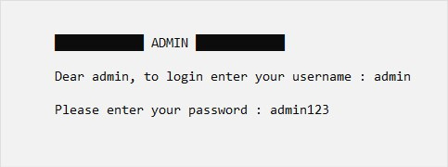
PROTOTYPE :
2 ) Easy Sign-Up And Login For Preserving And Securing Users Data.
1 ) Classic Menu Driven Style Program.

Slide 6
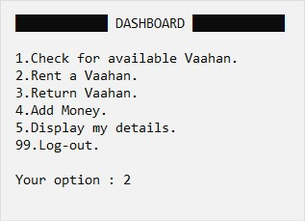
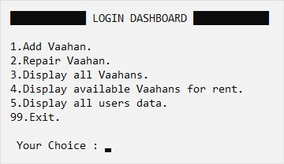
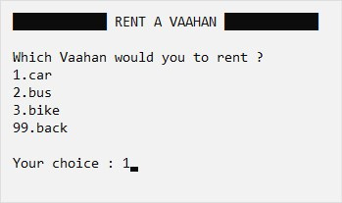



3 ) Equiped With Services Of Your Concern.
Handy For Both Customer And Provider.
4 ) Minimalistic Interface Design For Easy Deployment Over Other Platforms

Slide 7


Features :
Login System For Both Customer And Service Provider.
Variety Of Branded Vehicles Depending Upon Your Choice And Seamless Renting With Flexible Deployment.
Customer Invoice Provided For Transparency.

Slide 8




Requirements For Building This Project :
Visual Studio Code For java for systematic working environment.
Knowledge of Object Oriented Design and Programming and file handling.
Database Management Skills.
CLI Designing.

Slide 9
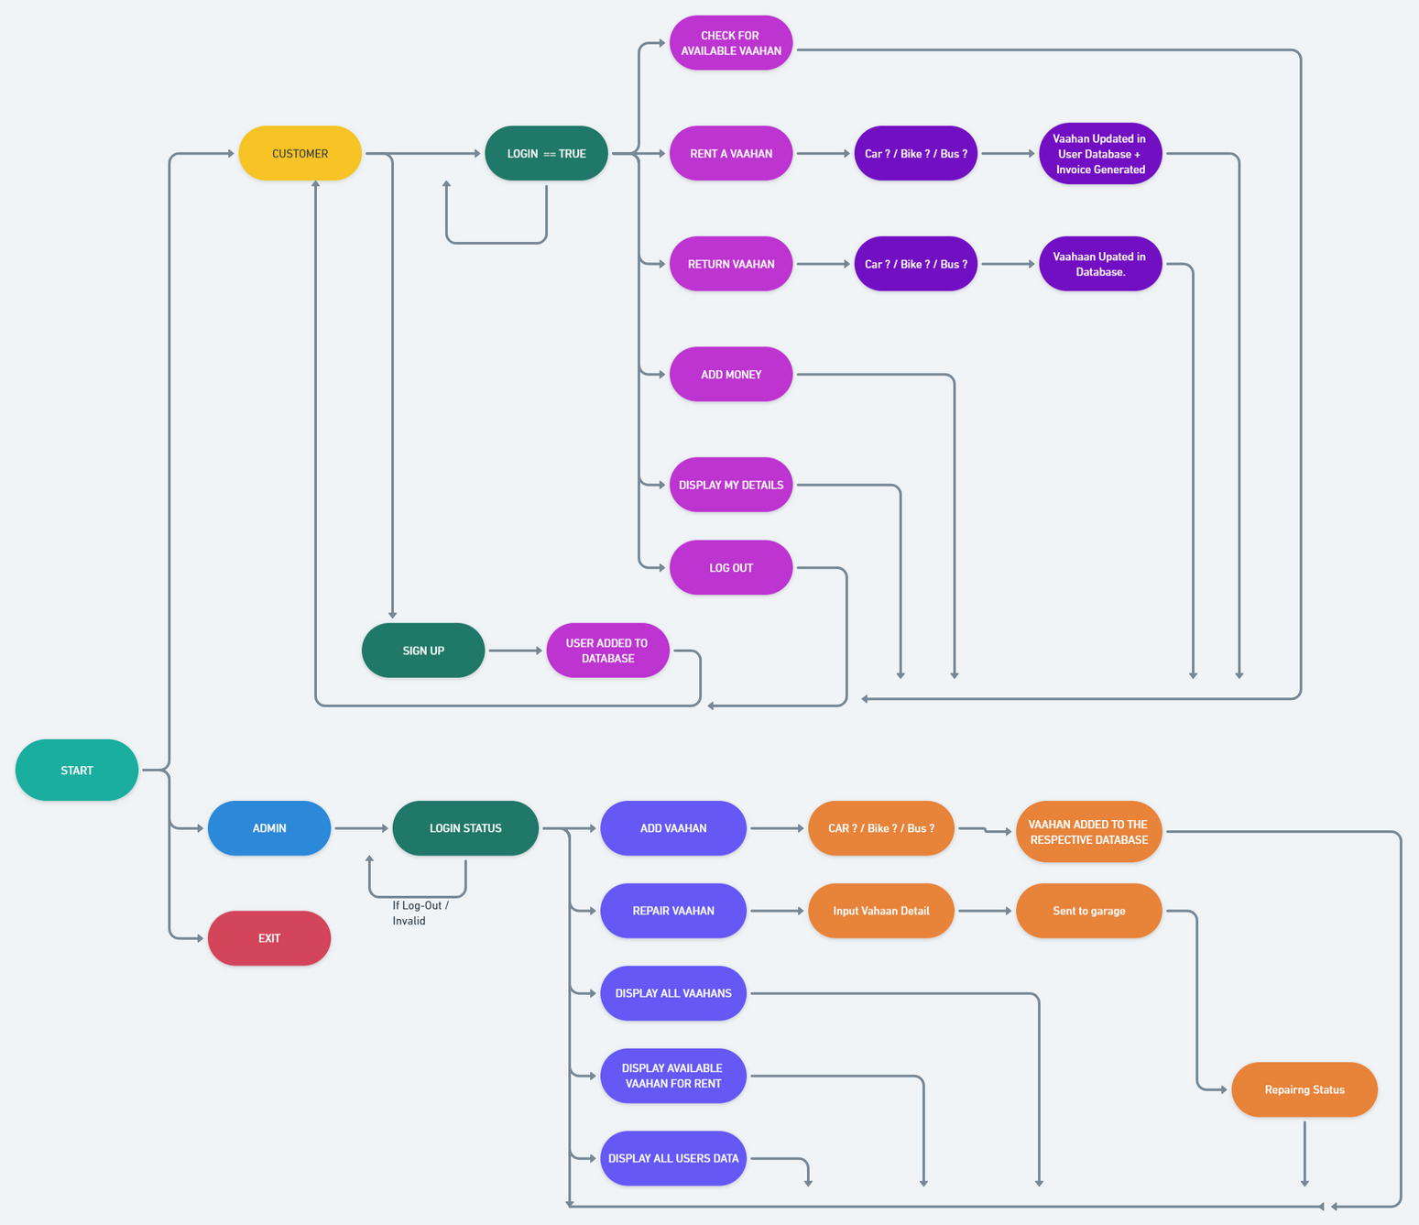


WORKING METHODOLOGY
https://whimsical.com/vaahan-wallah-NHcnVTUqyVJPYEUgYa7vCz
FLOWCHART OF SYSTEM

Slide 10
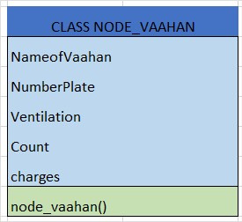
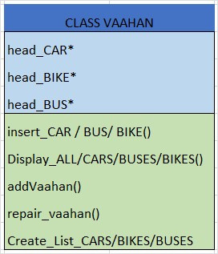
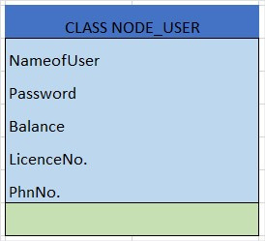
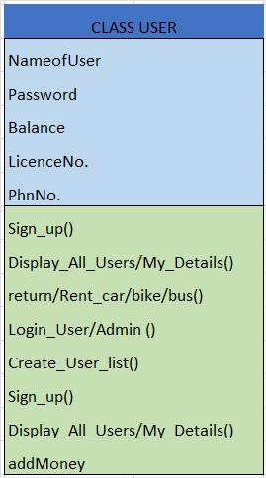

BLUEPRINT OF OUR SYSTEM
INHERITED

Slide 11
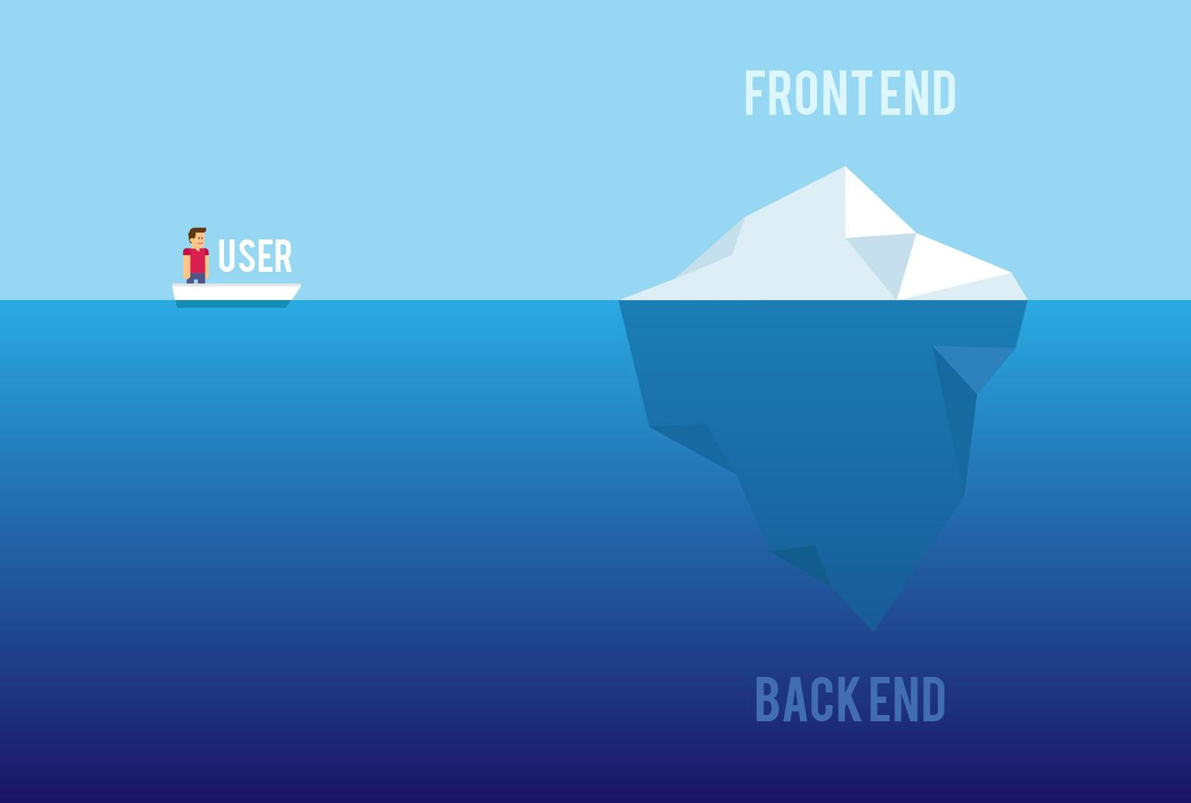

PROGRAM PROFILE & CONCEPTS USED :
FRONT-END :
Designing / Animating CLI Using java
BACK-END :
ENCAPSULATION
ABSTACTION
INHERITANCE (SINGLE LEVEL)
FILE HANDLING USING .TXT FILE

Slide 12
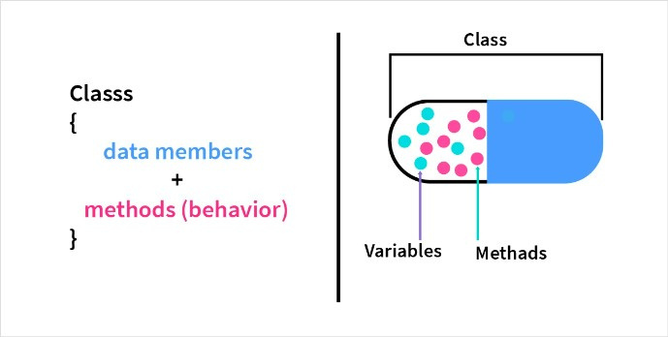
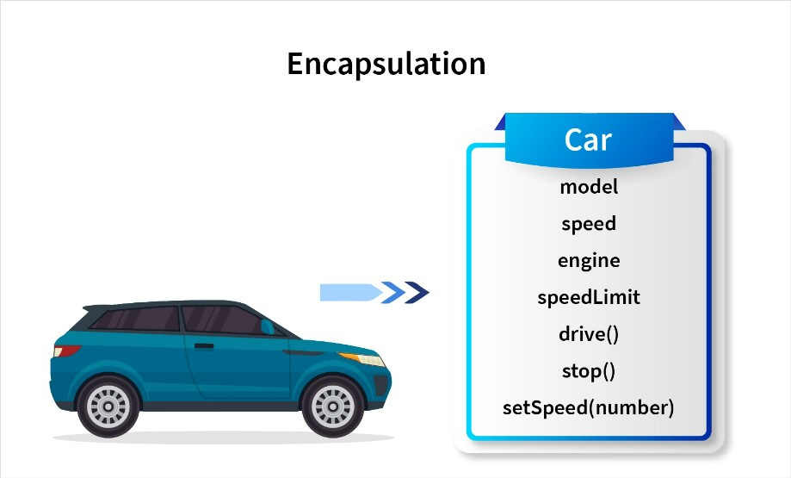
ENCAPSULATION :
Encapsulation is defined as the wrapping up of data under a single unit. It is the mechanism that binds together code and the data it manipulates. Another way to think about encapsulation is, that it is a protective shield that prevents the data from being accessed by the code outside this shield.

Slide 13
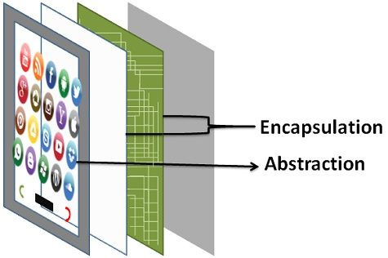
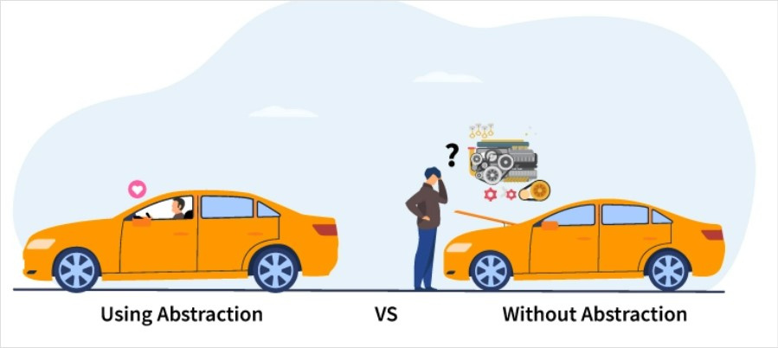

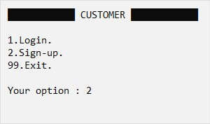
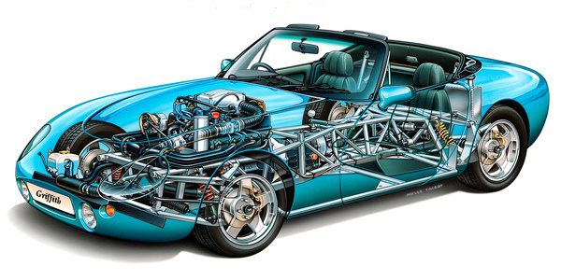
ABSTRACTION:
Abstraction is one of the key concepts of object-oriented programming (OOP) languages. Its main goal is to handle complexity by hiding unnecessary details from the user. That enables the user to implement more complex logic on top of the provided abstraction without understanding or even thinking about all the hidden complexity.
SMARTPHONE

Slide 14
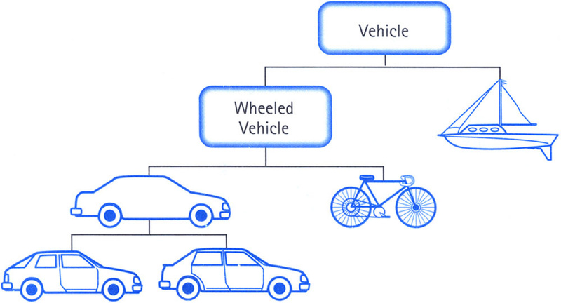
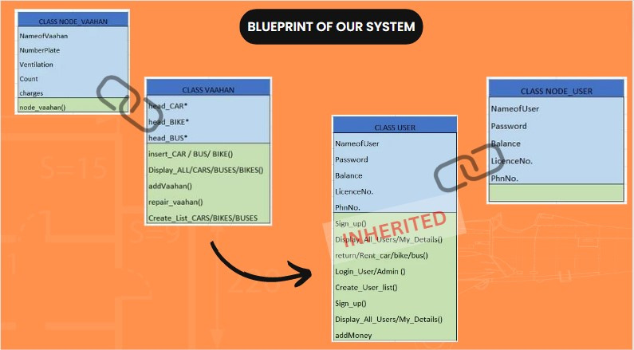
INHERITANCE :
The capability of a class to derive properties and characteristics from another class is called Inheritance. Inheritance is one of the most important features of Object-Oriented Programming.
Inheritance is a feature or a process in which, new classes are created from the existing classes. The new class created is called “derived class” or “child class” and the existing class is known as the “base class” or “parent class”. The derived class now is said to be inherited from the base class.

Slide 15


SCOPE OF IMPROVEMENT
Shifting From CLI TO GUI - Personalised Websites , Mobile And Desktop Apps.
FOR BETTER USER EXPERIENCE
More Types of Vaahans can be added.
GPS Monitoring System Can Be Added For Public And Asset Safety.
EXPANSION IN PROGRAM

Slide 16
THANK YOU

